Slide 1

May 2024
Garage System
Proposed By:
Usama Mohammed Mohammed Abdulgwad

Slide 2
Overview
01
02
03
04
Project Statement
Introduction &
Project Description
Project Major
Blocks & Block
Diagram
References &
Citations
05
06
Real-Time
Videography
Simulation
Videography

Slide 3

Problem Statement
Design and implement an automated garage management system using an AVR microcontroller. The system should monitor parking slots, control entrance and exit gates, and handle fire alarms. The solution must include a user interface via an LCD display and use sensors for detecting vehicles and temperature. The project’s main concerns is all about:
1. Parking Efficiency & Optimizing Space Usage: Ensures efficient use of parking space by accurately tracking available slots.
2. User Convenience: Provides real-time updates to drivers about parking availability, reducing the time spent searching for a slot.
3. Fire Detection: Enhances safety by monitoring temperature and triggering alarms in case of fire.
4. Automated Responses: Opens gates automatically during a fire to allow for quick evacuation, reducing human errors.
5. Ease of Access

Slide 4
Introduction &
Project Description
This project implements an automated garage management system using an ATmega32 microcontroller.
The system integrates various sensors to monitor and control the garage environment.
It includes features such as temperature monitoring with a fire alarm, ultrasonic sensors for detecting vehicle presence, servo motors for gate control, and an LCD display for user feedback.
The system optimizes parking space utilization by tracking available slots and providing real-time updates to users.
Overall, it offers a comprehensive solution for efficient and secure garage management.

Slide 5
Project Major Blocks
01
LCD & Input/Output Port
02
ADC: Temperature Sensor & Buzzer
03
Timers (Ultrasonic + Servo Motor)
04
Infrared Sensor

Slide 6
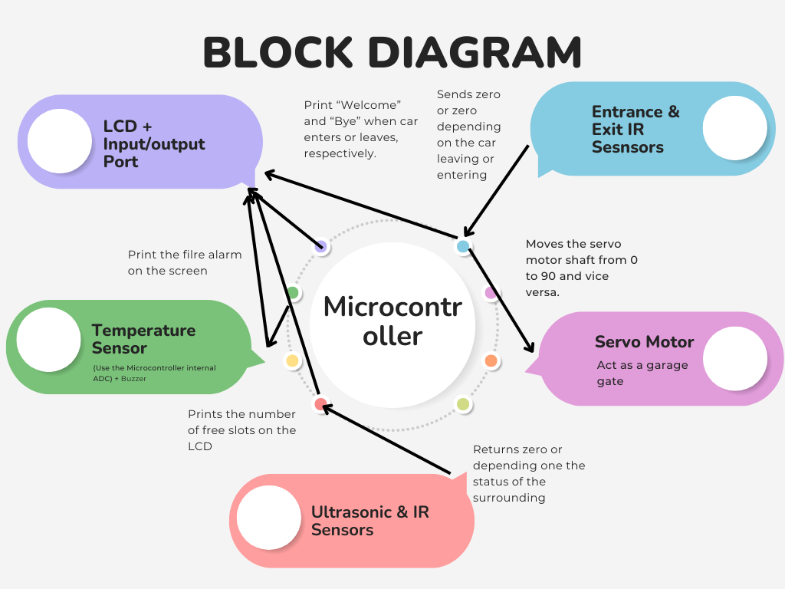

Slide 7
Input/Output & LCD

Slide 8
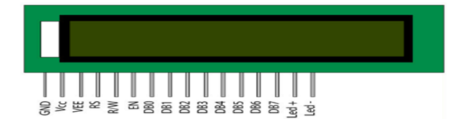
Introduction
Liquid crystals were discovered in the late 19th century by Friedrich Reinitzer, leading to the development of LCDs.
Practical applications emerged in the 1960s, with the first working LCD demonstrated by RCA.
The dynamic scattering mode (DSM) in 1968 enabled more energy-efficient LCD displays.
LCDs revolutionized electronics with advancements in color, portability, and display technology, becoming ubiquitous in devices like calculators, TVs, and smartphones.
LCD stands for Liquid Crystal Display. It can be used to display anything. They are of many types. The ones we commonly use for embedded systems, robotics, etc. are of two types: 1- character LCD 2- graphical LCD
LCDs have become a cheap and easy way to get text display for an embedded system.

Slide 9
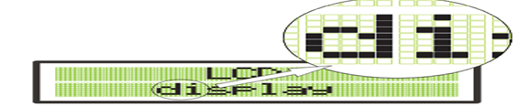
Overview of 5x8 Dot Matrix Displays
A 5X8 dots display consists of a matrix of lights or mechanical indicators arranged in a rectangular configuration.
By switching on or off selected lights, text or graphics can be displayed.

Slide 10
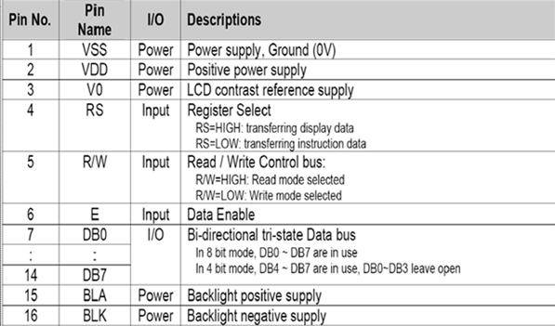
LCD PINS
1. VSS (Ground):- Connect to ground (0V).
2. VDD (Power): - Connect to power supply (+5V or +3.3V).
3. VO (Contrast):- Adjust contrast with a potentiometer.
4. RS (Register Select):
- 0: Command mode.
- 1: Data mode.
5. R/W (Read/Write):
- 0: Write to LCD.
- 1: Read from LCD (often grounded for writing only).
6. E (Enable): Enable data transfer
7. D0-D7 (Data Lines): - 8-bit data bus for commands and data.
8. A (Anode):- Positive terminal of the backlight.
9. K (Cathode): - Negative terminal of the backlight.

Slide 11
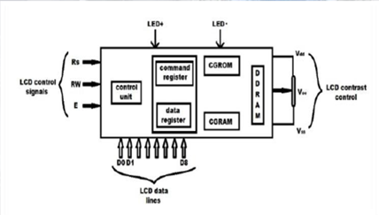
LCD Components:
1. DDRAM (Display Data RAM
2. CGROM (Character Generator ROM3. DR (Data Register4. CR (Command Register
3. MPU (Microcontroller Unit)
4. Address Counter

Slide 12
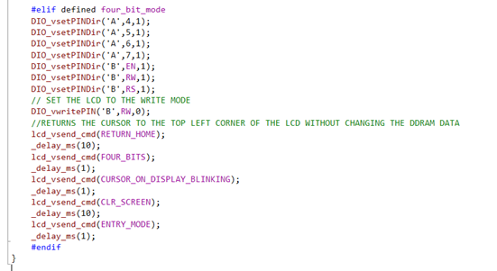
How LCD Is Interfaced in Our Code
4-bit Mode
In 4-bit mode, data is sent to the LCD in two nibbles (4 bits each). This mode uses fewer microcontroller pins, which is advantageous in pin-limited applications, but requires two operations to send each byte.
Characteristics:
Data Lines: Uses only 4 data lines (typically D4-D7).
Commands/Data: Each 8-bit command or data byte is split into two 4-bit nibbles and sent sequentially.
Speed: Slightly slower due to the need to send two nibbles per byte.
Pin Usage: Requires 7 pins (4 data pins + 3 control pins: RS, RW, EN).
Initialization Command: The command to initialize the LCD in 4-bit mode starts with 0x02 (to set 4-bit mode) followed by 0x28 (FOUR_BITS).

Slide 13
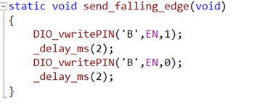
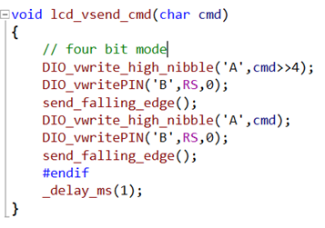
How LCD Is Interfaced in Our Code
This function creates a falling edge signal on the EN pin of the LCD used to trigger
Set the RS=0 to indicating that the command being sent is not character data
falling edge triggering the LCD controller to process the command, write to the higher nibble of the LCD data bus and then write four last four bit

Slide 14
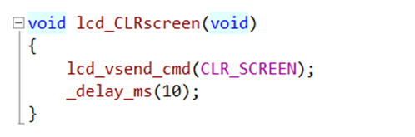
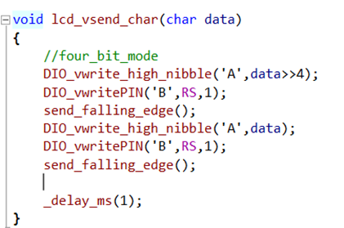
How LCD Is Interfaced in Our Code
To clear screen we send command #define CLR_SCREEN 0x01 to clear it by use lcd_vsend_cmd(char cmd )
This function to send character to LCD set RS 1 indicating that the data being sent is character data, not a command,
send_falling_edge(): Generates a falling edge signal on the EN (Enable) pin of the LCD, triggering the LCD controller to process the character data
and we Writes the lower higher nibble of the character data

Slide 15
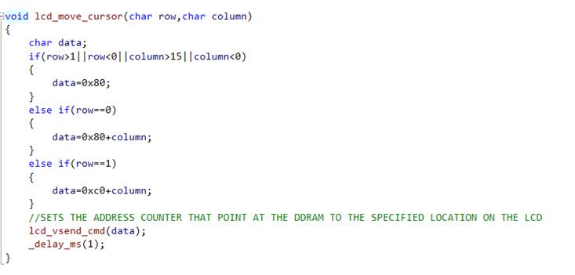
How LCD Is Interfaced in Our Code
The first check if the row and column not valid it send cmd 0x80, which moves the cursor to the home position (top-left corner).
If the row is 0 (top row), calculates the data value based on the specified column and adds it to 0x80.
If the row is 1 (bottom row), calculates the data value based on the specified column and adds it to 0xC0

Slide 16
ADC C: Temperature & Buzzer

Slide 17
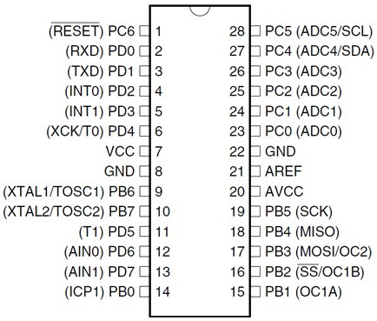
Atmega32's Analog-to-Digital Converter
It is 10-bit ADC (Resolution bits)
Converted output binary data is held in two special functions 8-bit register ADCL (result Low) and ADCH (result in High).
ADC gives 10-bit output, so (ADCH: ADCL) only 10-bits are useful out of 16-bits with the options to use the higher or lower bits.
We also have three options for Vref. 1) AVcc (analog Vcc), 2) Internal 2.56v (The used one) 3). External Aref. Pin.
The ADC Channels are of the successive approximation type.

Slide 18
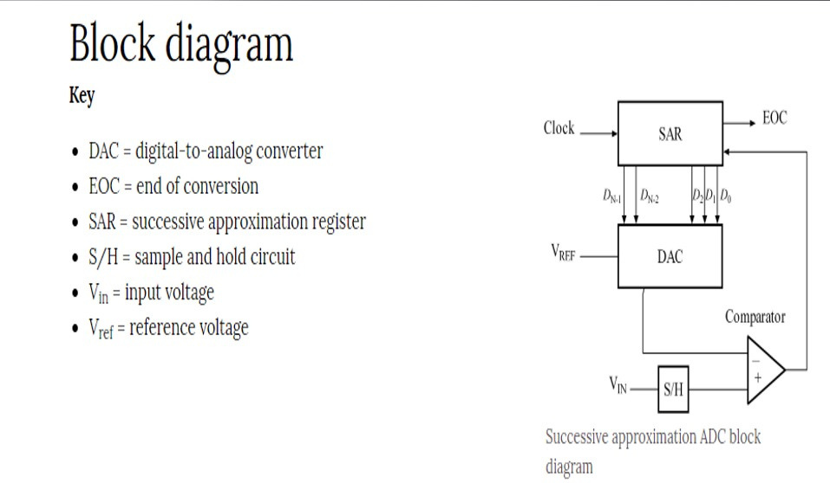
Successive Approximation ADC Block Diagram

Slide 19
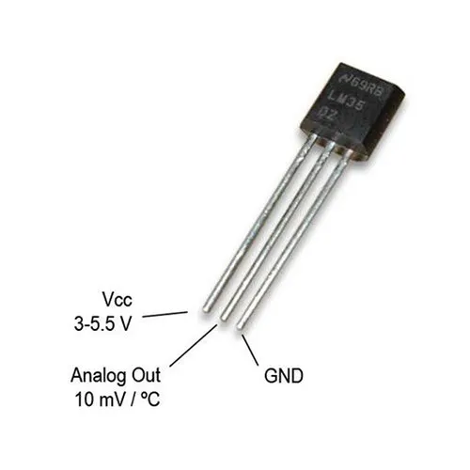
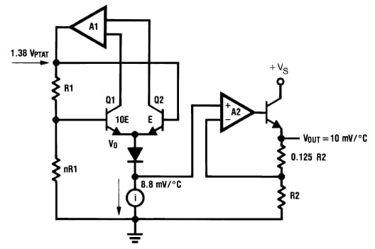
Temperature Sensor
The LM35 is a precision integrated-circuit temperature sensor.
The LM35 is a semiconductor temperature sensor
Its output voltage is linearly proportional to the Celsius (Centigrade) temperature.
Key Features:
Calibrated directly in Celsius (Centigrade)
Linear +10.0 mV/°C scale factor
0.5°C accuracy guaranteeable (at +25°C)
Rated for full −55° to +150°C range
Suitable for remote applications
Operates from 4 to 30 volts
Less than 60 µA current drain
Low impedance output, 0.1 Ohm for 1 mA load

Slide 20
Temperature Sensor
Advantages of LM35 over Resistive Temperature Detectors (RTDs):
Ease of Use:
Direct Output: The LM35 provides a direct voltage output that is linearly proportional to the temperature in Celsius (10 mV per °C), making it straightforward to interface with microcontrollers and other digital systems without needing complex signal conditioning.
No Calibration Required: The LM35 does not require external calibration.
Lower Cost:
Low Power Consumption: The LM35 typically operates at very low power levels (less than 60 µA current drain), making it suitable for battery-powered and low-power applications.
Simplicity in Circuitry:
Simple Circuitry: The LM35 can be used with minimal additional components, often just requiring a direct connection to an analog-to-digital converter (ADC) on a microcontroller.
Compact Size:
Adequate Temperature Range: While RTDs can offer very wide temperature ranges, the LM35’s range of −55°C to +150°C is sufficient for many standard applications.
All in all, while RTDs offer high accuracy and stability, the LM35 is advantageous in terms of ease of use, cost, simplicity, and power efficiency, making it suitable for a wide range of everyday temperature sensing applications.

Slide 21
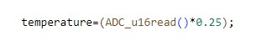
How Temperature is Measured in Our Code:
Given that the resolution bits are 10, so we 2^(10) steps with the maximum analog voltage value from the micorcontroller as 2.56V
So every step counts for 2.56/1024 = 2.5*10^(-3)
Given that the slope of LM35 is 10mv/C
so the value obtained from the ADC should be multiplied by 2.5*10^(-3) / (10*10^-3) = 0.25

Slide 22
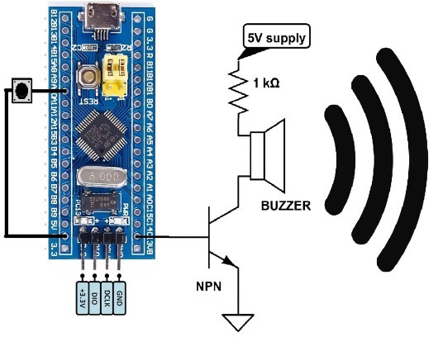
Buzzer
Buzzer as a high-current device is connected to an NPN transistor when working with atmega32 microcontroller
The Vcc (5v) in this case is connected to the buzzer through an arbitrary resister, while the buzzer being connected to the collecter of the NPN transistor and the base is connected to the microcontroller and grounding the emitter, as shown.
By using an NPN transistor, we can safely and efficiently control a high-current device like a buzzer with the limited current and voltage capabilities of the ATmega32 microcontroller, while also providing protection and ensuring reliable operation.

Slide 23

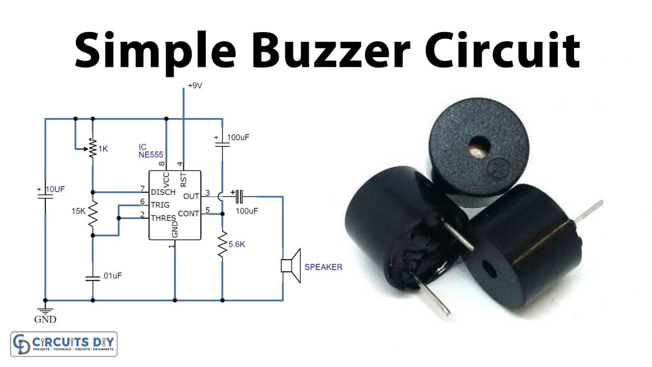

Slide 24
Timers (Ultrasonic + Servo Motor )

Slide 25

Timers (Ultrasonic + Servo Motor )
In this section we will be talking about timers in the Atmega32 AVR which are a very important peripherals in the microcontroller, as they are used to control many devices and sensors such as the ultrasonic sensor and the servo motor which we have used in our project.

Slide 26
3 timers in our Atmega32 :
1.Timer0 : It is a general purpose, single compare unit, 8-bit Timer/Counter module. The main features are:
Single Compare Unit Counter.
Clear Timer on Compare Match (Auto Reload).
Frequency Generator.
10-bit Clock Prescaler.
Overflow and Compare Match Interrupt Sources (TOV0 and OCF0).
2.Timer2 : Similar to timer0 in everything except for one extra feature that it has over timer0 and that it allows clocking from External 32kHz Watch Crystal Independent of the I/O Clock.
3.Timer1 : It is a 16-bit Timer unit that allows accurate program execution timing (event management), wave generation, and signal timing measurement. The main features are:
True 16-bit Design (that is, allows 16-bit PWM).
Two Independent Output Compare Units.
One Input Capture Unit.
Input Capture Noise Canceler.
Clear Timer on Compare Match (Auto Reload).
Glitch-free, Phase Correct Pulse Width Modulator (PWM).
Variable PWM Period.
Frequency Generator.
External Event Counter.
Four Independent Interrupt Sources (TOV1, OCF1A, OCF1B, and ICF1).

Slide 27
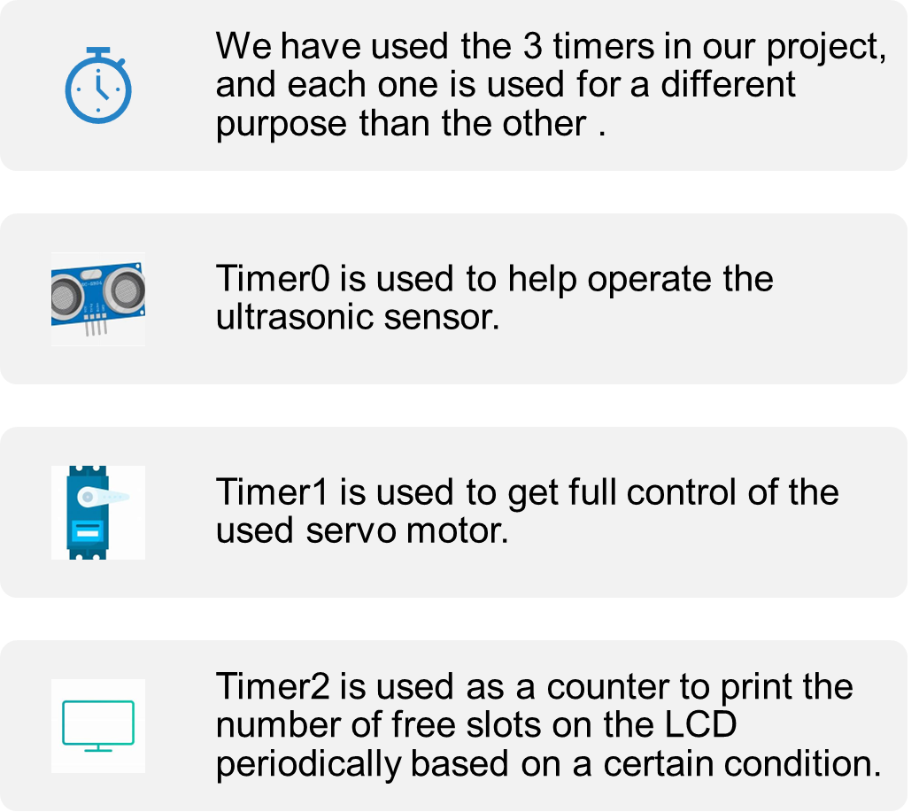
Timers In our garage

Slide 28
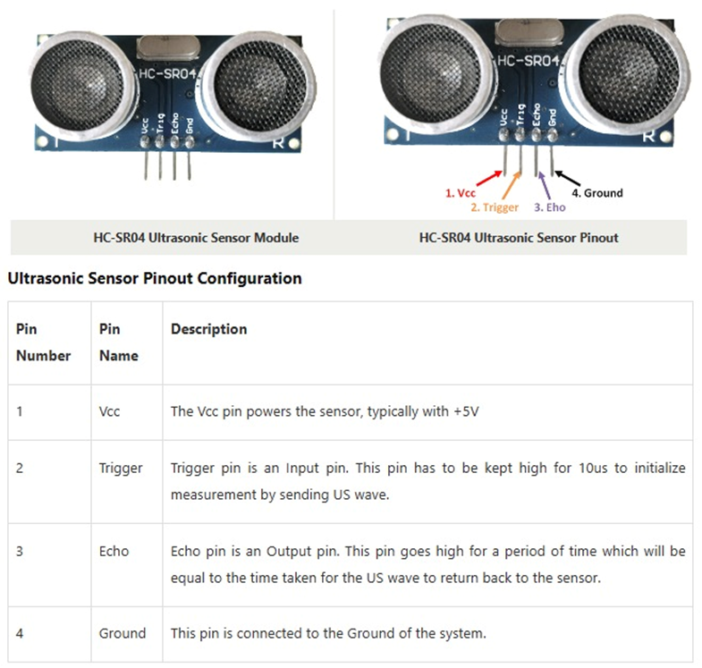
Ultrasonic sensor and Timer0
How the Ultrasonic Sensor Works (General)
Triggering the Sensor: The control circuit sends a short pulse to the transmitter, telling it to emit an ultrasonic sound wave.
Sound Wave Emission: The transmitter emits a sound wave at a specific frequency.
Waiting for Echo: The receiver listens for the echo of the sound wave that has bounced off an object and returned to the sensor.
Time Calculation: The control circuit measures the time taken for the echo to return.
Distance Calculation: Using the speed of sound, the sensor calculates the distance based on the time interval. The formula used is:
Distance =(Time × Speed of Sound)/2
The division by 2 accounts for the fact that the sound wave travels to the object and back.

Slide 29

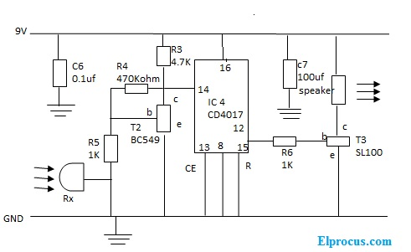
Ultrasonic Internal Circuit

Slide 30
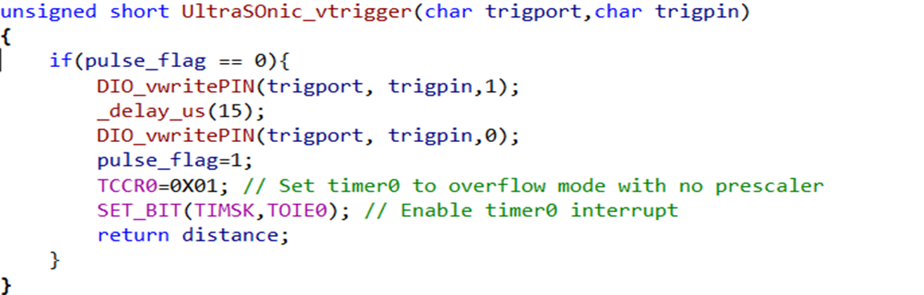
How the Ultrasonic works (in our code) :
Initializing the Ultrasonic Sensor

Slide 31
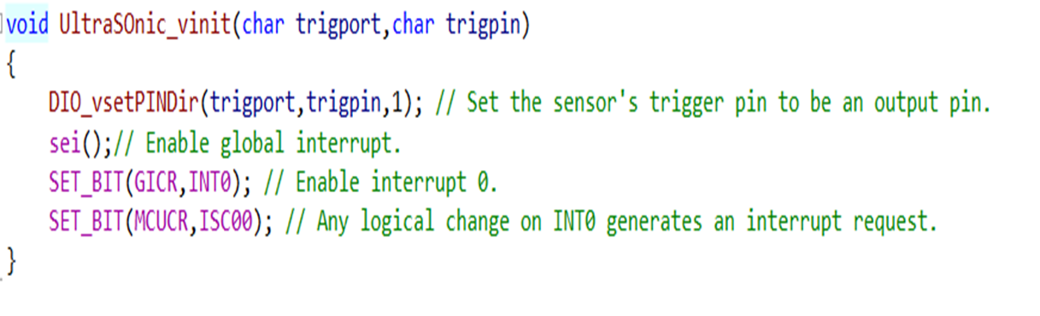
How the Ultrasonic works (in our code) :
Triggering the UltrasonicSensor, set timer0 to start counting, and enable interrupt0

Slide 32
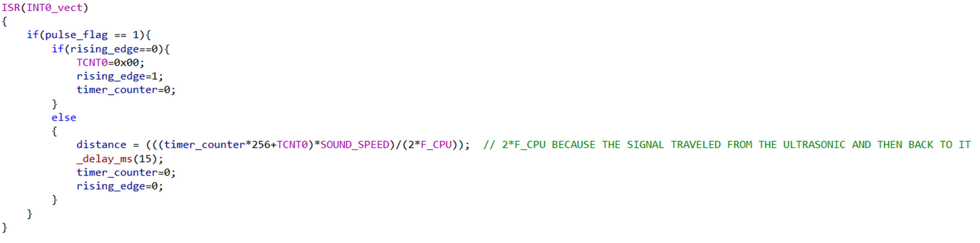
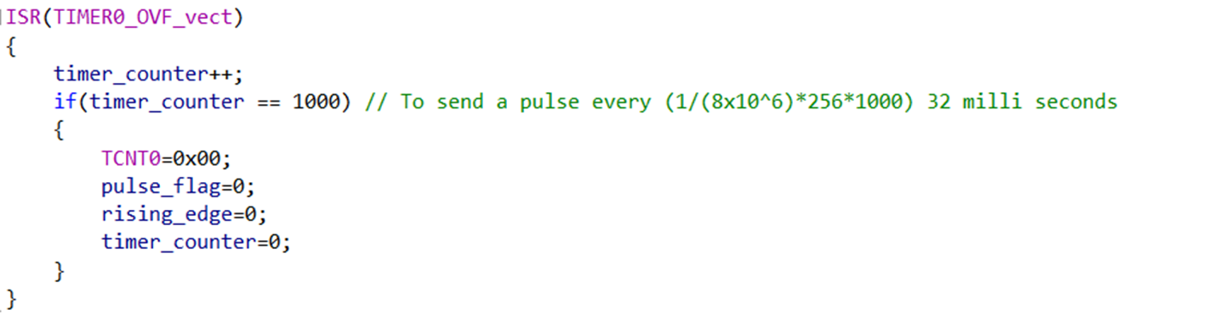
How the Ultrasonic works (in our code) :
Interrupt service routine function for interrupt0:
Interrupt service routine function for timer0:

Slide 33
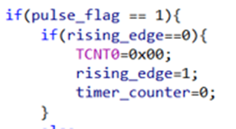
How the Ultrasonic works (in our code):
We have set the INT0 to call the ISR on any logical change (when the echo pin of the ultrasonic sends a pulse and when that pulse ends).
We have set the timer0 to the overflow mode (normal mode) so whenever the timer register TCNT0 reaches its top (255), Its ISR is called, the ‘timer_counter’ variable inside the ISR is incremented to indicate how many times the TCNT0 reaches its top, and by this we can calculate the time of the pulse sent by the ultrasonic sensor.
Knowing that the used frequency of microcontroller inside the code is 8 MHz then the periodic time (time taken to increment the TCNT0 by one is 1/(8 x10^6), by multiplying this number by 256 and by the ‘timer_counter’ then adding them to the TCNT0 , in case a new counting cycle has started and hasn’t reached the top yet, we can calculate the width of the sent pulse).
When the ultrasonic sensor is triggered, the timer starts counting and the ISR(INT0_vect) will be executed simultaneously. By the first logical change the ISR(INT0_vect) will be called and this code :
will be executed to ensure that the TCNT0 starts counting from 0 and to assign 0 to ‘timer_counter’.By the second logical change the following code will be executed to calculate the distance detected by
the ultrasonic sensor :

Slide 34
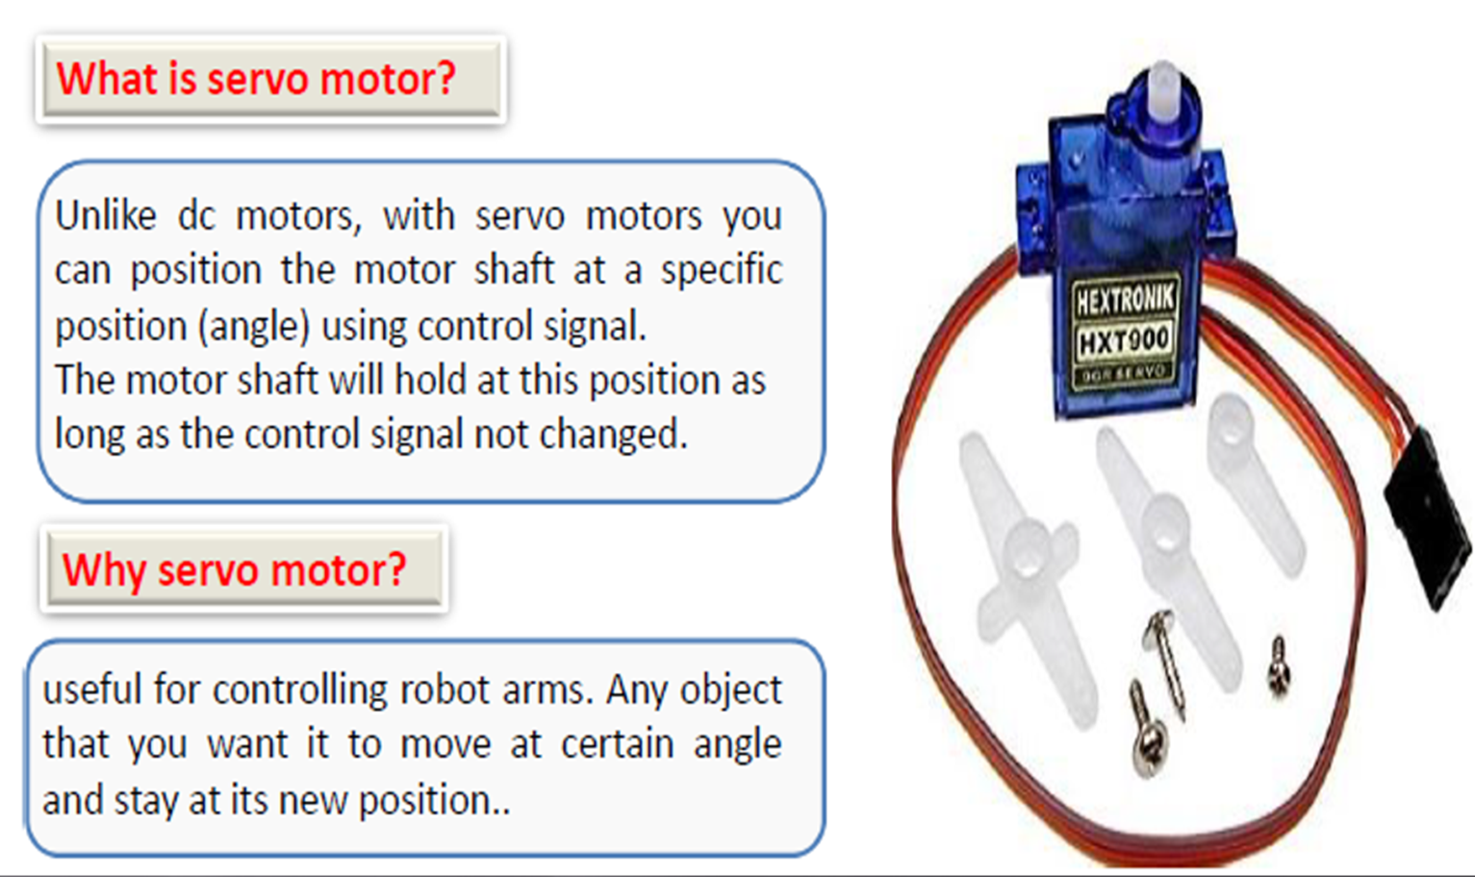
Servo motor and Timer1

Slide 35
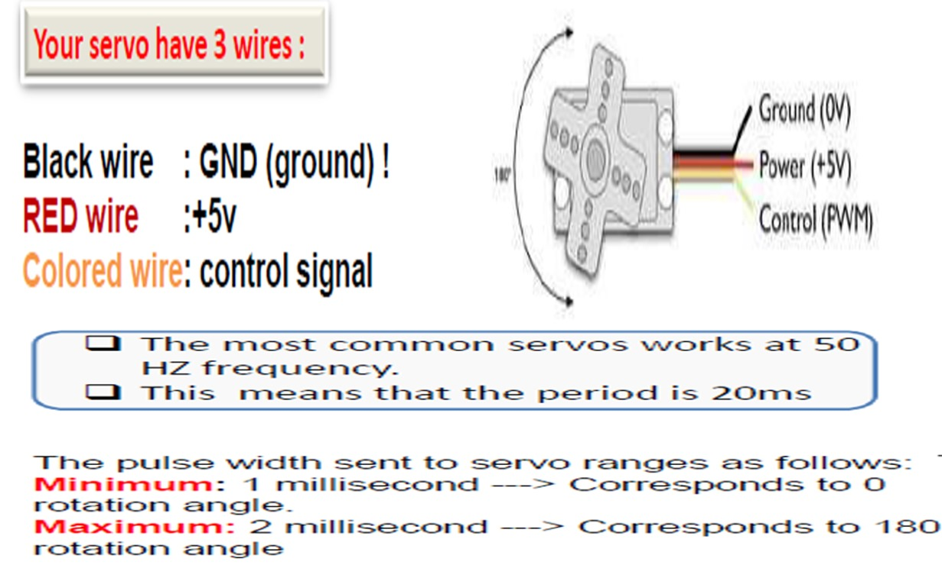

Slide 36
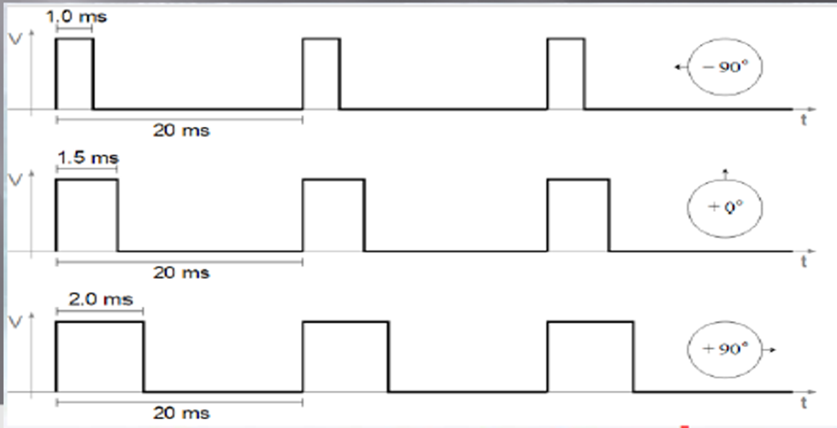
How Does A Servo Motor Work
•Usually, a servo motor turns 90° in either direction, i.e. maximum movement can be 180°
Three wires are taken out of a servo: positive, ground and control wire.
A servo motor is controlled by sending a Pulse Width Modulated (PWM) signal through the control wire. A pulse is sent every 20 milliseconds.
Width of the pulses determine the position of the shaft. For example, a pulse of 1ms will move the shaft anticlockwise at -90°, a pulse of 1.5ms will move the shaft at the neutral position that 0° and a pulse of 2ms will move the shaft clockwise at+90.

Slide 37
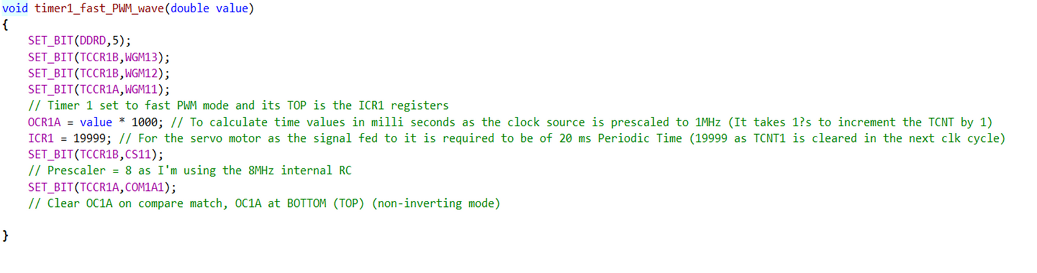
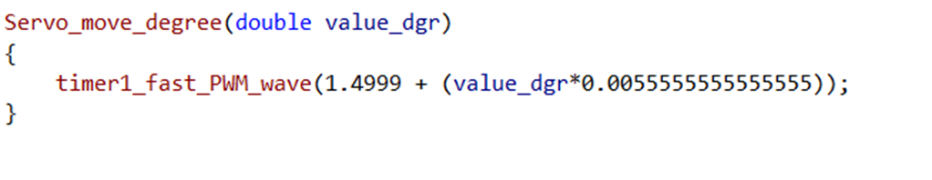
Here is how we used timer1 to be able to fully control the servo motor:

Slide 38
Here is how we used timer1 to be able to fully control the servo motor:
We use the function ‘servo_move_degree’ to send the desired position (degree) we want our servo motor to move to. Knowing that the servo’s shaft moves 90° per 0.5 milli second pulse then it moves 1 degree per 0.005555555 (0.5/90) milli second pulse, adding this number to 1.4999 then sending it to the ‘timer1_fast_PWM_wave’ function to load the OCR1A by the result*1000 to output the exact width of the desired pulse on the servo motor’s pin.

Slide 39
Infrared Sensor

Slide 40
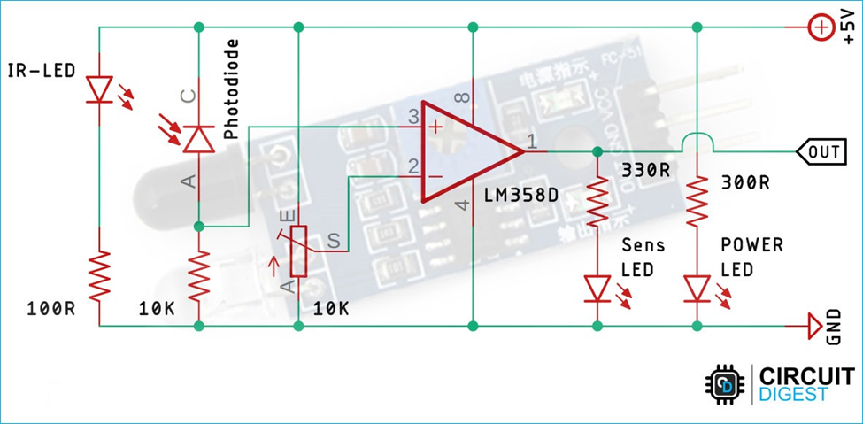
Datasheet:

Slide 41
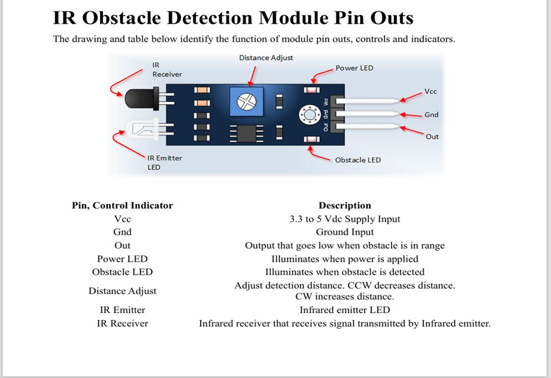
Datasheet:

Slide 42
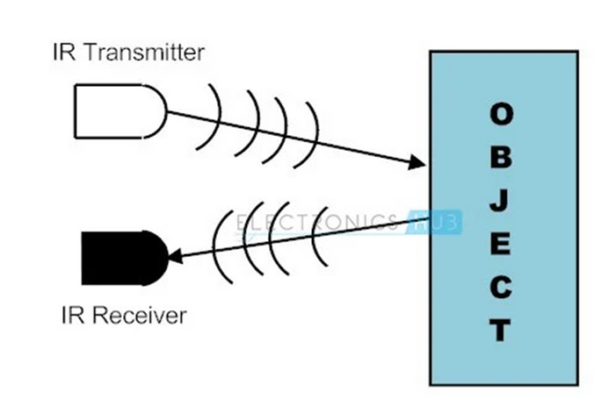
How Infrared Sensors Work (General)
Infrared sensors, adaptable to ambient light, feature a pair of infrared emitting and receiving tubes. The transmitting tubes emit infrared light at a certain frequency, and when an obstacle is detected, the reflected infrared light is received by the receiving tube.
After processing by a comparator circuit, a green light indicates detection, and the signal output interface generates a digital signal (a low-level signal). The detection distance, ranging from 2 to 30 cm, can be adjusted using a potentiometer.
These sensors operate at a working voltage of 3.3V to 5V. With minimal interference and ease of assembly and use, these sensors are widely used in applications such as robot obstacle avoidance, avoidance cars, line counting, and black and white line tracking.
Infrared sensors leverage the incredibly fast speed of light, approximately 299,792,458 meters per second (or 186,282 miles per second), to detect objects efficiently.

Slide 43
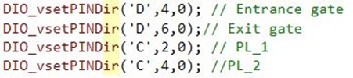
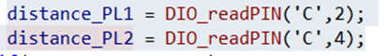
How Ultrasonic Sensor Works (In Our Code):
Here we are initializing port D pin 4, 6 for entrance and exit gates, and port C pin 2, 4 for parking slots 1 and 2 of the infrared sensor in the Atmega32.
Here we retrieve a value of 0 to indicate an object detected, while 1 indicates no object present, in parking slots 1 and

Slide 44
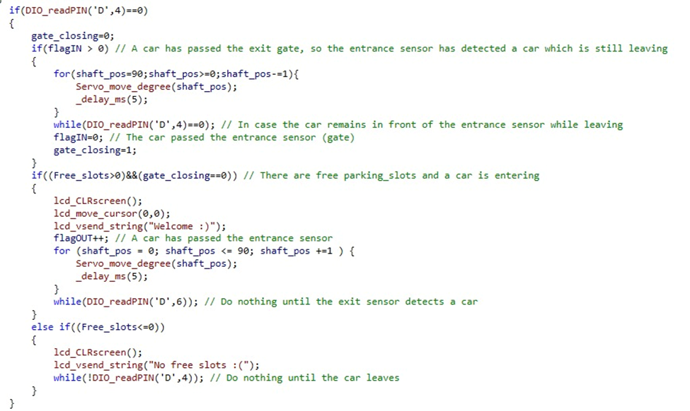
How Ultrasonic Sensor Works (In Our Code):

Slide 45
How Ultrasonic Sensor Works (In Our Code):
Here, first check the DIO. _readPIN('D',4) If it equals 0, that means there is a car wanting to enter, so we check.
if(free_slots<=0) Here we want to print out on the LCD; there`s no space in the garage, and the while (!DIO_readPIN('D',4)) That`s to say, if there`s a car still waiting in front of the garage, it's still in the while loop until the car leaves.
If((free_slots>0)&&(gate_closing==0))
That's to check if there`s a parking slot and the gate is closing.and printout in the lcd welcome. So we will increment the flagout and open the gate, then the while (DIO_readPIN('D',6)) that`s mean is still in loop until the sensor in (DIO_readPIN('D',6) reads the car and be a 0 so we will getout from the loop .
if(flagIN>0) that`s mean close the garage and the while (DIO. _readPIN('D',4)) that’s mean still in the loop until the carr pass the first gate

Slide 46
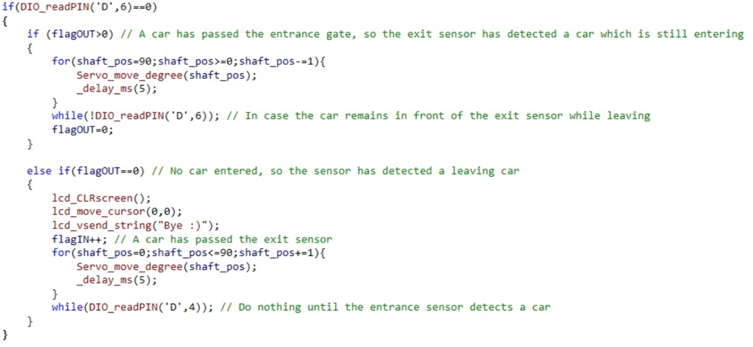
How Ultrasonic Sensor Works (In Our Code):

Slide 47
How Ultrasonic Sensor Works (In Our Code):
Here, first check the DIO_readPIN('D',6) If it equals 0, that means there is a car wanting to exit, so we check.
1. if (flagOUT==0) in there we output in the lcd screen bye then increment the flagIN and open the gate then join to the while (DIO_readPIN('D',4) that`s mean is still in loop until the sensor in (DIO_readPIN('D',4) read the car and be a 0.
2. If (flagOUT>0) in there the total car is exit from the garage and close the gate. And the while (!DIO_readPIN('D',6)) That’s meant to check if there is a car or not.

Slide 48
References & Citations

Slide 49
LM35 Precision Centigrade Temperature Sensors Datasheet: https://www.ti.com/lit/ds/symlink/lm35.pdf
LM35-Temperature-Sensor-Interfacing-With-ATmega32 - GitHub Repository: https://github.com/omaarelsherif/LM35-Temperature-Sensor-Interfacing-With-ATmega32
HC SR04 Ultrasonic Datasheet : https://www.handsontec.com/dataspecs/HC-SR04-Ultrasonic.pdf
Arduino Ir Infrared obstacle avoidance Sensor Module: https://5.imimg.com/data5/YT/KV/MY-1833510/arduino-ir-infrared-obstacle-avoidance-sensor-module.pdf
Servo Motor datasheet: http://www.ee.ic.ac.uk/pcheung/teaching/DE1_EE/stores/sg90_datasheet.pdf

Slide 50
Simulation Videography

Slide 51
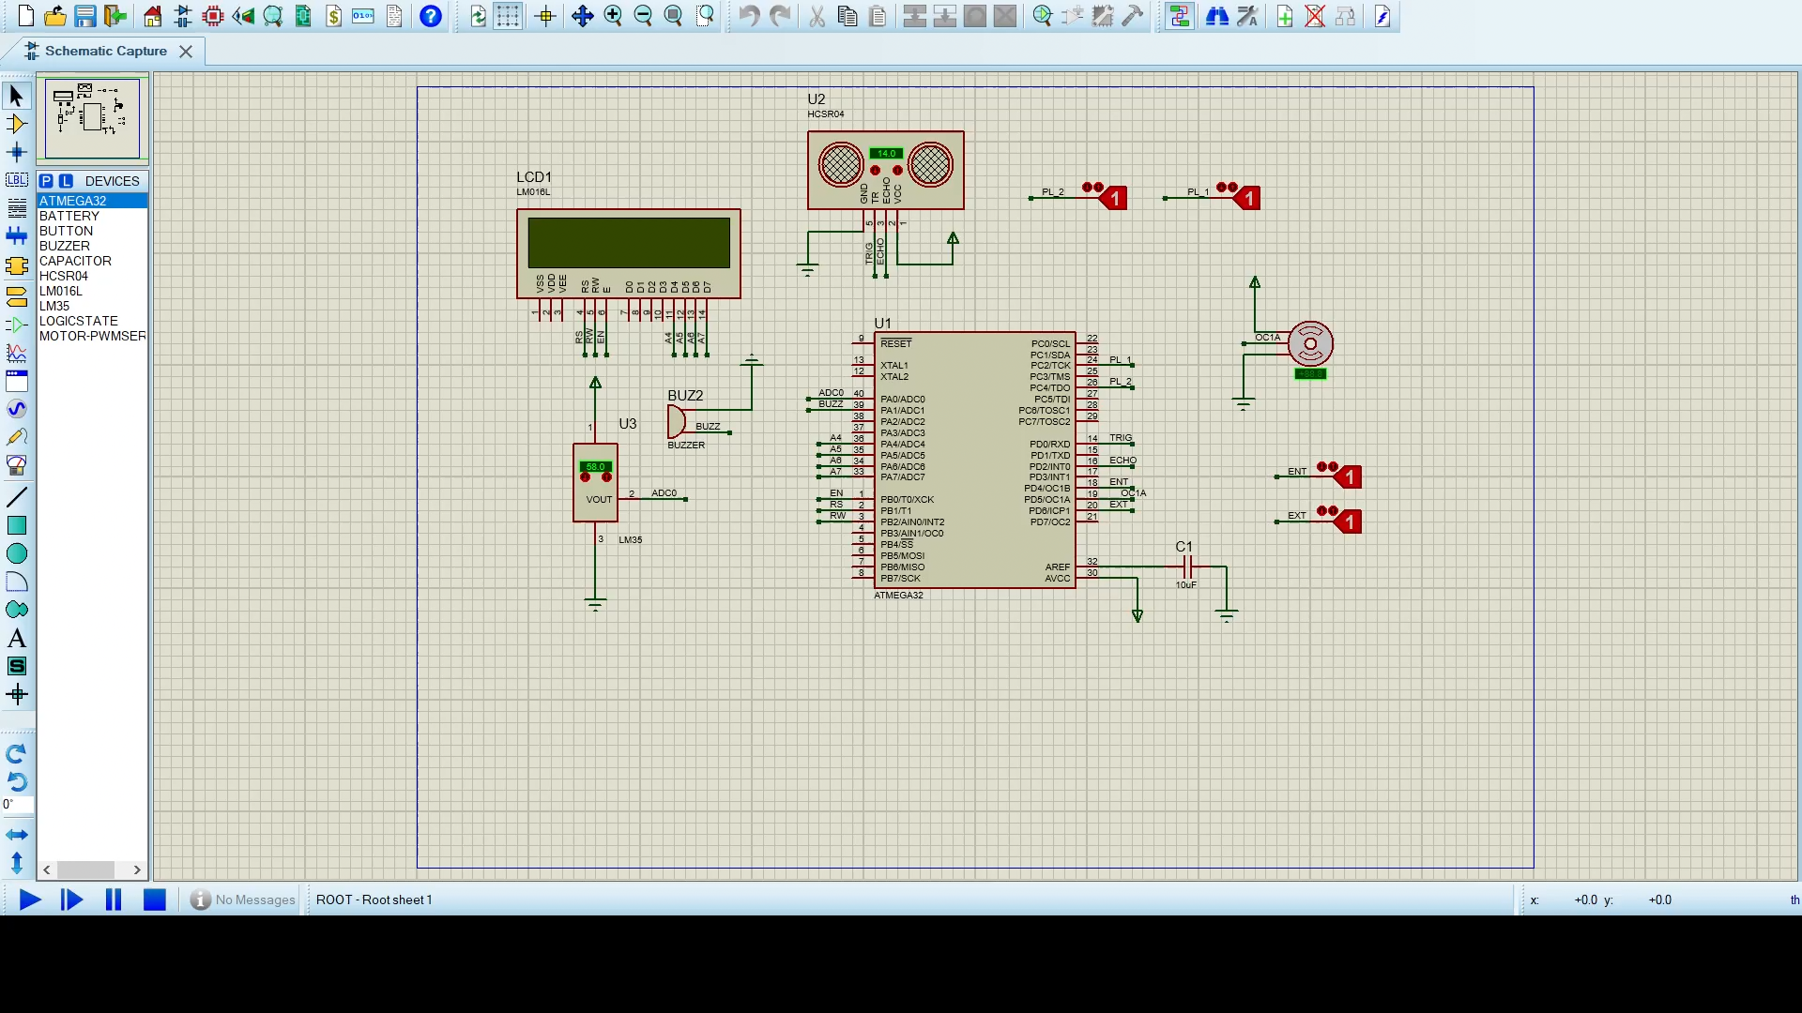

Slide 52
Real-Time Videograph

Slide 53
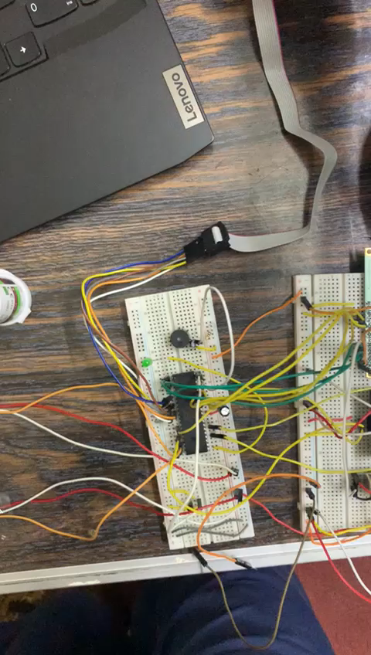

Slide 54
Thank You

